Slide 1
TITANIC SURVIVAL PREDICTION
By
M.VAMSI KRISHNA –2473A39087
SHAIK AFTAB AHMED -2473A39116

Slide 2
PROBLEM STATEMENT
Predict whether a passenger survived the Titanic disaster.
Problem Type:
• Supervised Learning
• Binary Classification
Target Variable:
0 → Not Survived
1 → Survived

Slide 3
PROJECT WORKFLOW
Importing the required libraries
Understanding the data set
Exploratory data analysis
Data preprocessing
Model building
Evaluation metrics ( using validation data)
Choosing model
Prediction

Slide 4
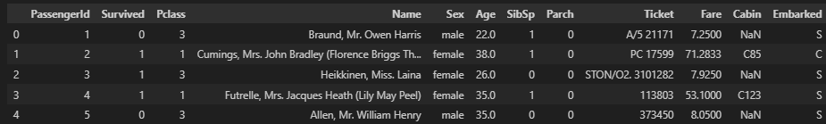
DATASET OVERVIEW
Source: Kaggle – Titanic: Machine Learning from Disaster
Total Records: 891
Total Features: 12
Key Features:
• Pclass
• Sex
• Age
• Fare
• SibSp
• Parch
• Embarked

Slide 5
EXPLORATORY DATA ANALYSIS
Survival distribution
Feature wise survival analysis
Detecting outliers
Skewness check
Irrelevant features

Slide 6
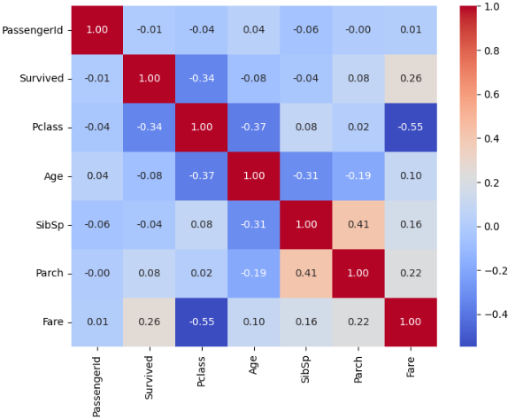
KEY INSIGHTS FROM EDA
Survival Distribution:
• 62% Did Not Survive
• 38% Survived
Fare-Gender Impact:
• Females ≈ 75% Survival
• Males ≈ 80% Mortality
Class Impact:
• Pclass -vely correlated with survival
Fare Impact:
• Higher Fare Higher Survival Probability

Slide 7
DATA PREPROCESSING
Handling missing values
Removing irrelevant or redundant features
Encoding the categorical variables
Feature scaling

Slide 8
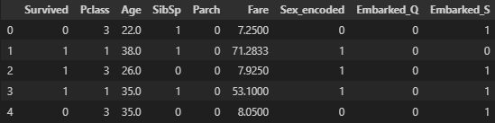
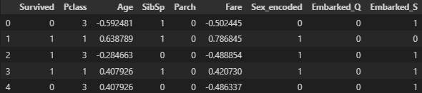
After applying ONE HOT ENCODING on Embarked column :
After applying Z-SCORE SCALING on age and Fare column :
Z-score scaling → X new = ( X - mean ) / variance

Slide 9
FEATURE SELECTION
Selected Features:
Pclass
Age
Fare
Sex_encoded
Embarked_Q
Embarked_S
Data Split:
80% Training
20% Validation (Stratified)

Slide 10
MODEL BUILDING
Models implemented
Logistic regression
Decision tree
Random forest
Goal : compare performance and select best model

Slide 11
EVALUATION METRICS
Confusion matrix :[ A/P[ TP , FN ] , [ FP , TN ]]
Accuracy : (TP + TN ) / ( TP + FN + FP + TN )
Precision : TP / ( TP + FP )
Recall : TP / ( TP + FN )
f1-score : harmonic mean( precision & recall )
Used multiple metrics due to class imbalance

Slide 12
CHOOSING THE BEST MODEL
Logistic Regression → Strong baseline
Decision Tree → Risk of over-fitting
Random Forest → Best overall performance
1. Handle non linear interactions
2. Reduces over-fitting
3. Robust to noise and missing patterns
Final Selected Model: Random Forest

Slide 13
ADVANTAGES
Practical Application of ML Concepts
Comparative model analysis
Performance based model selection
Handling real world data challenges
Interpretability

Slide 14
LIMITATIONS
Limited dataset size
Historical & simplified data
Class imbalance
Model generalization
Hyper-parameter optimization scope

Slide 15
CONCLUSION
• Gender and Passenger Class are strongest predictors
• Socio-economic status influenced survival
• Ensemble learning improved performance

